Slide 1
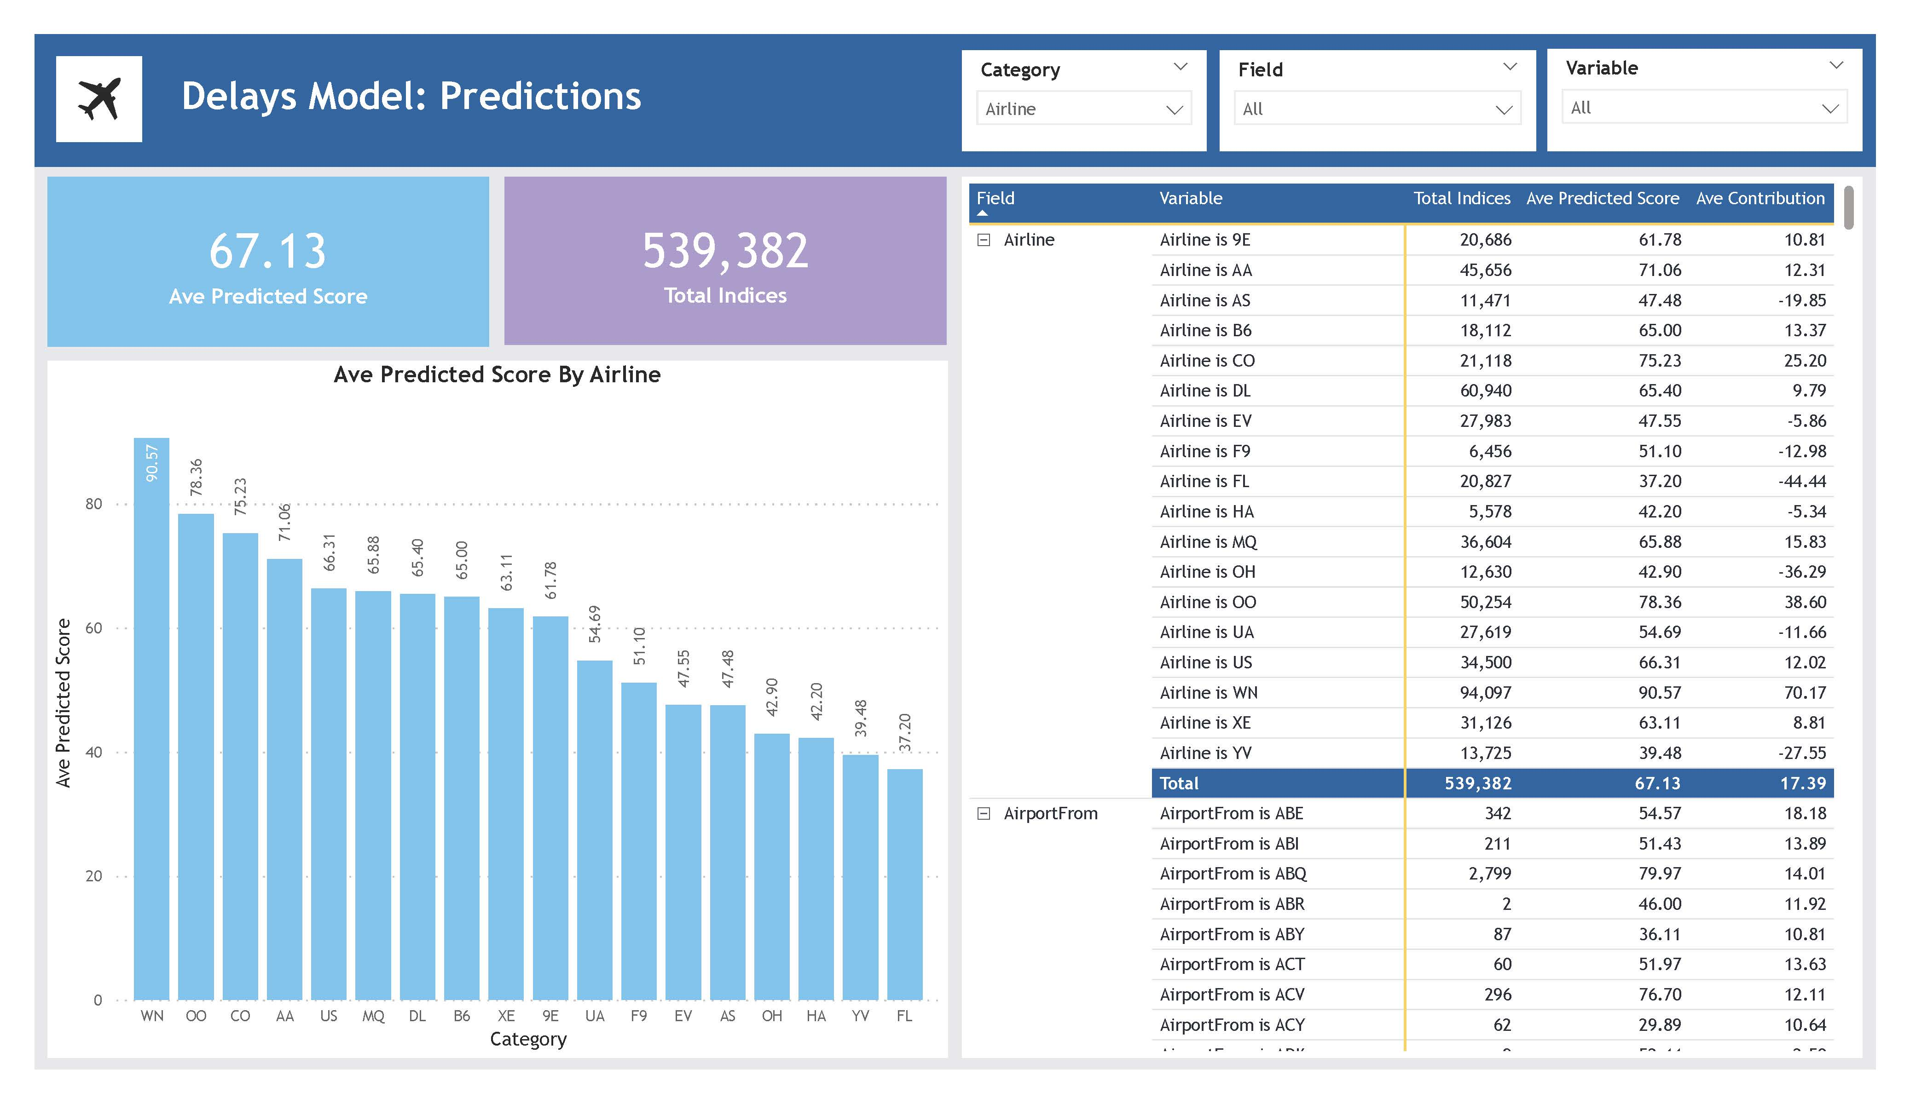



Load: Power BI Service
Transform: Data flows & Power Query
Build ML model
Extract: Excel File in Power BI Service
Build Report in Power BI Desktop
Publish App in Power BI Service
Airlines Delays Power BI ML

Slide 2
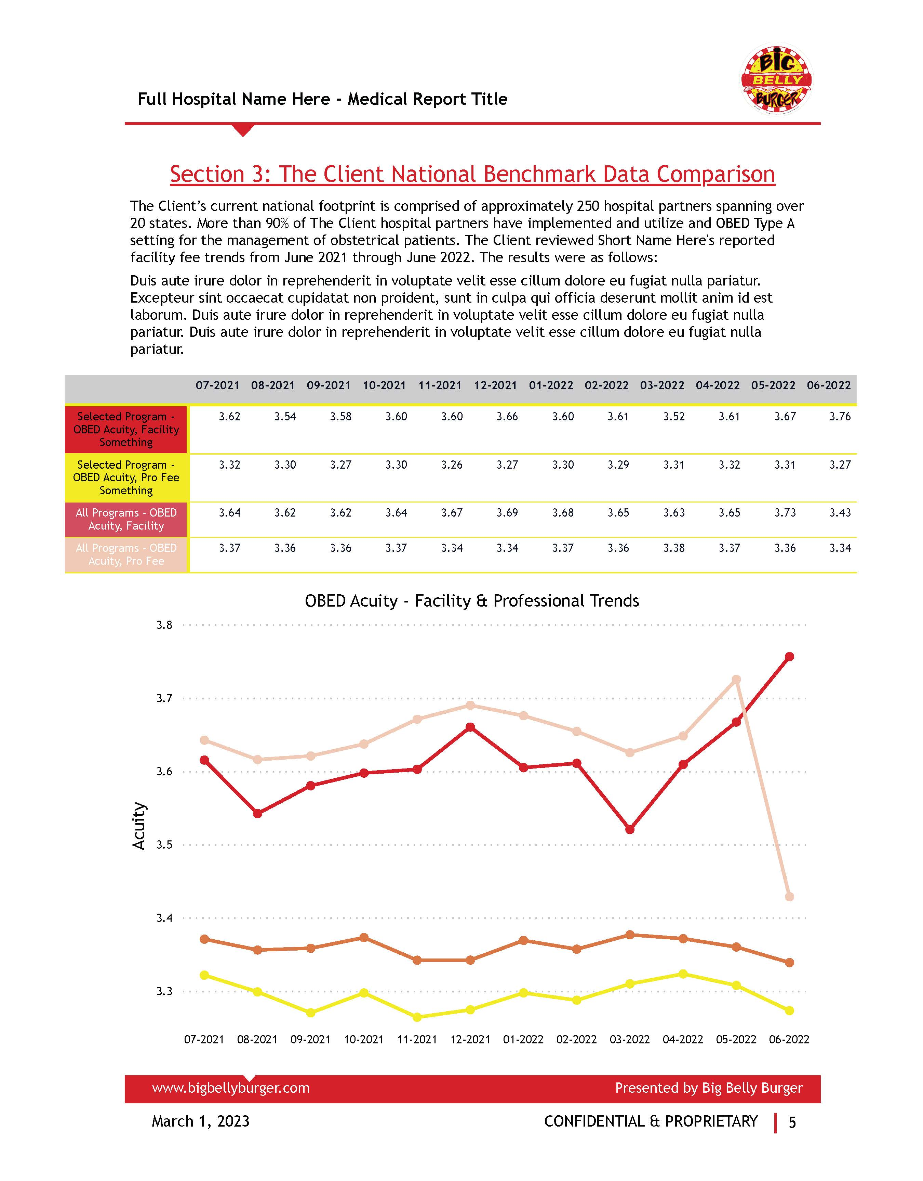

Extract: Excel File in Sharepoint
Load: Power BI
Transform: Power Query
Build Report
Publish App in Power BI Service
Automated Medical Financial Reporting

Slide 3
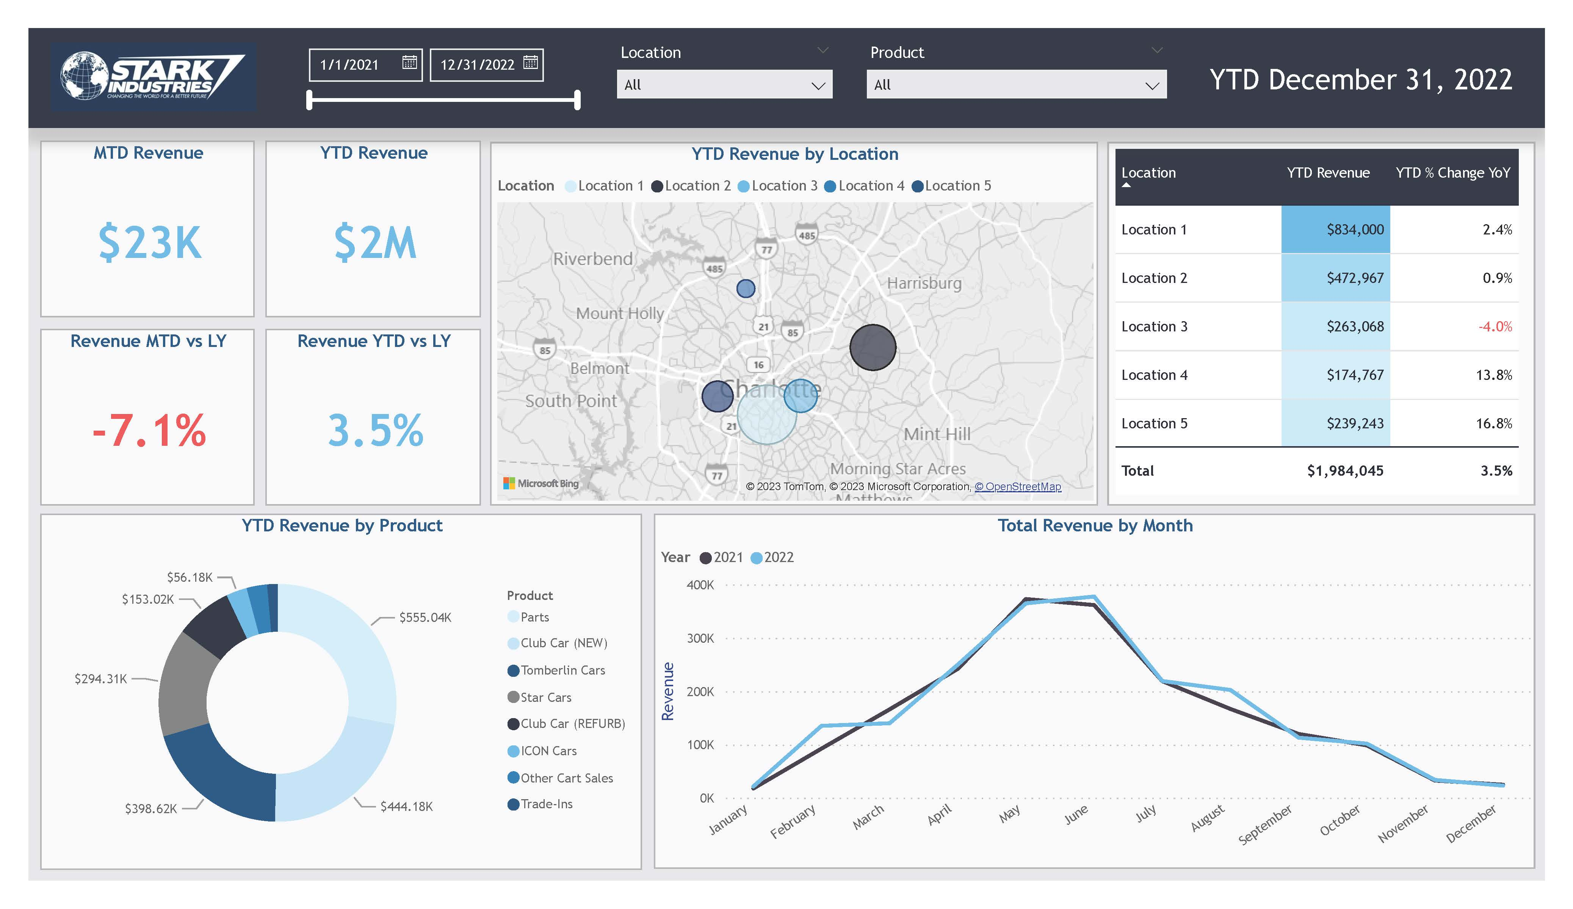
Extract: Excel File in Sharepoint
Load: Power BI
Transform: Power Query
Build Report
Publish App in Power BI Service
Client Proposal Dashboard

Slide 4
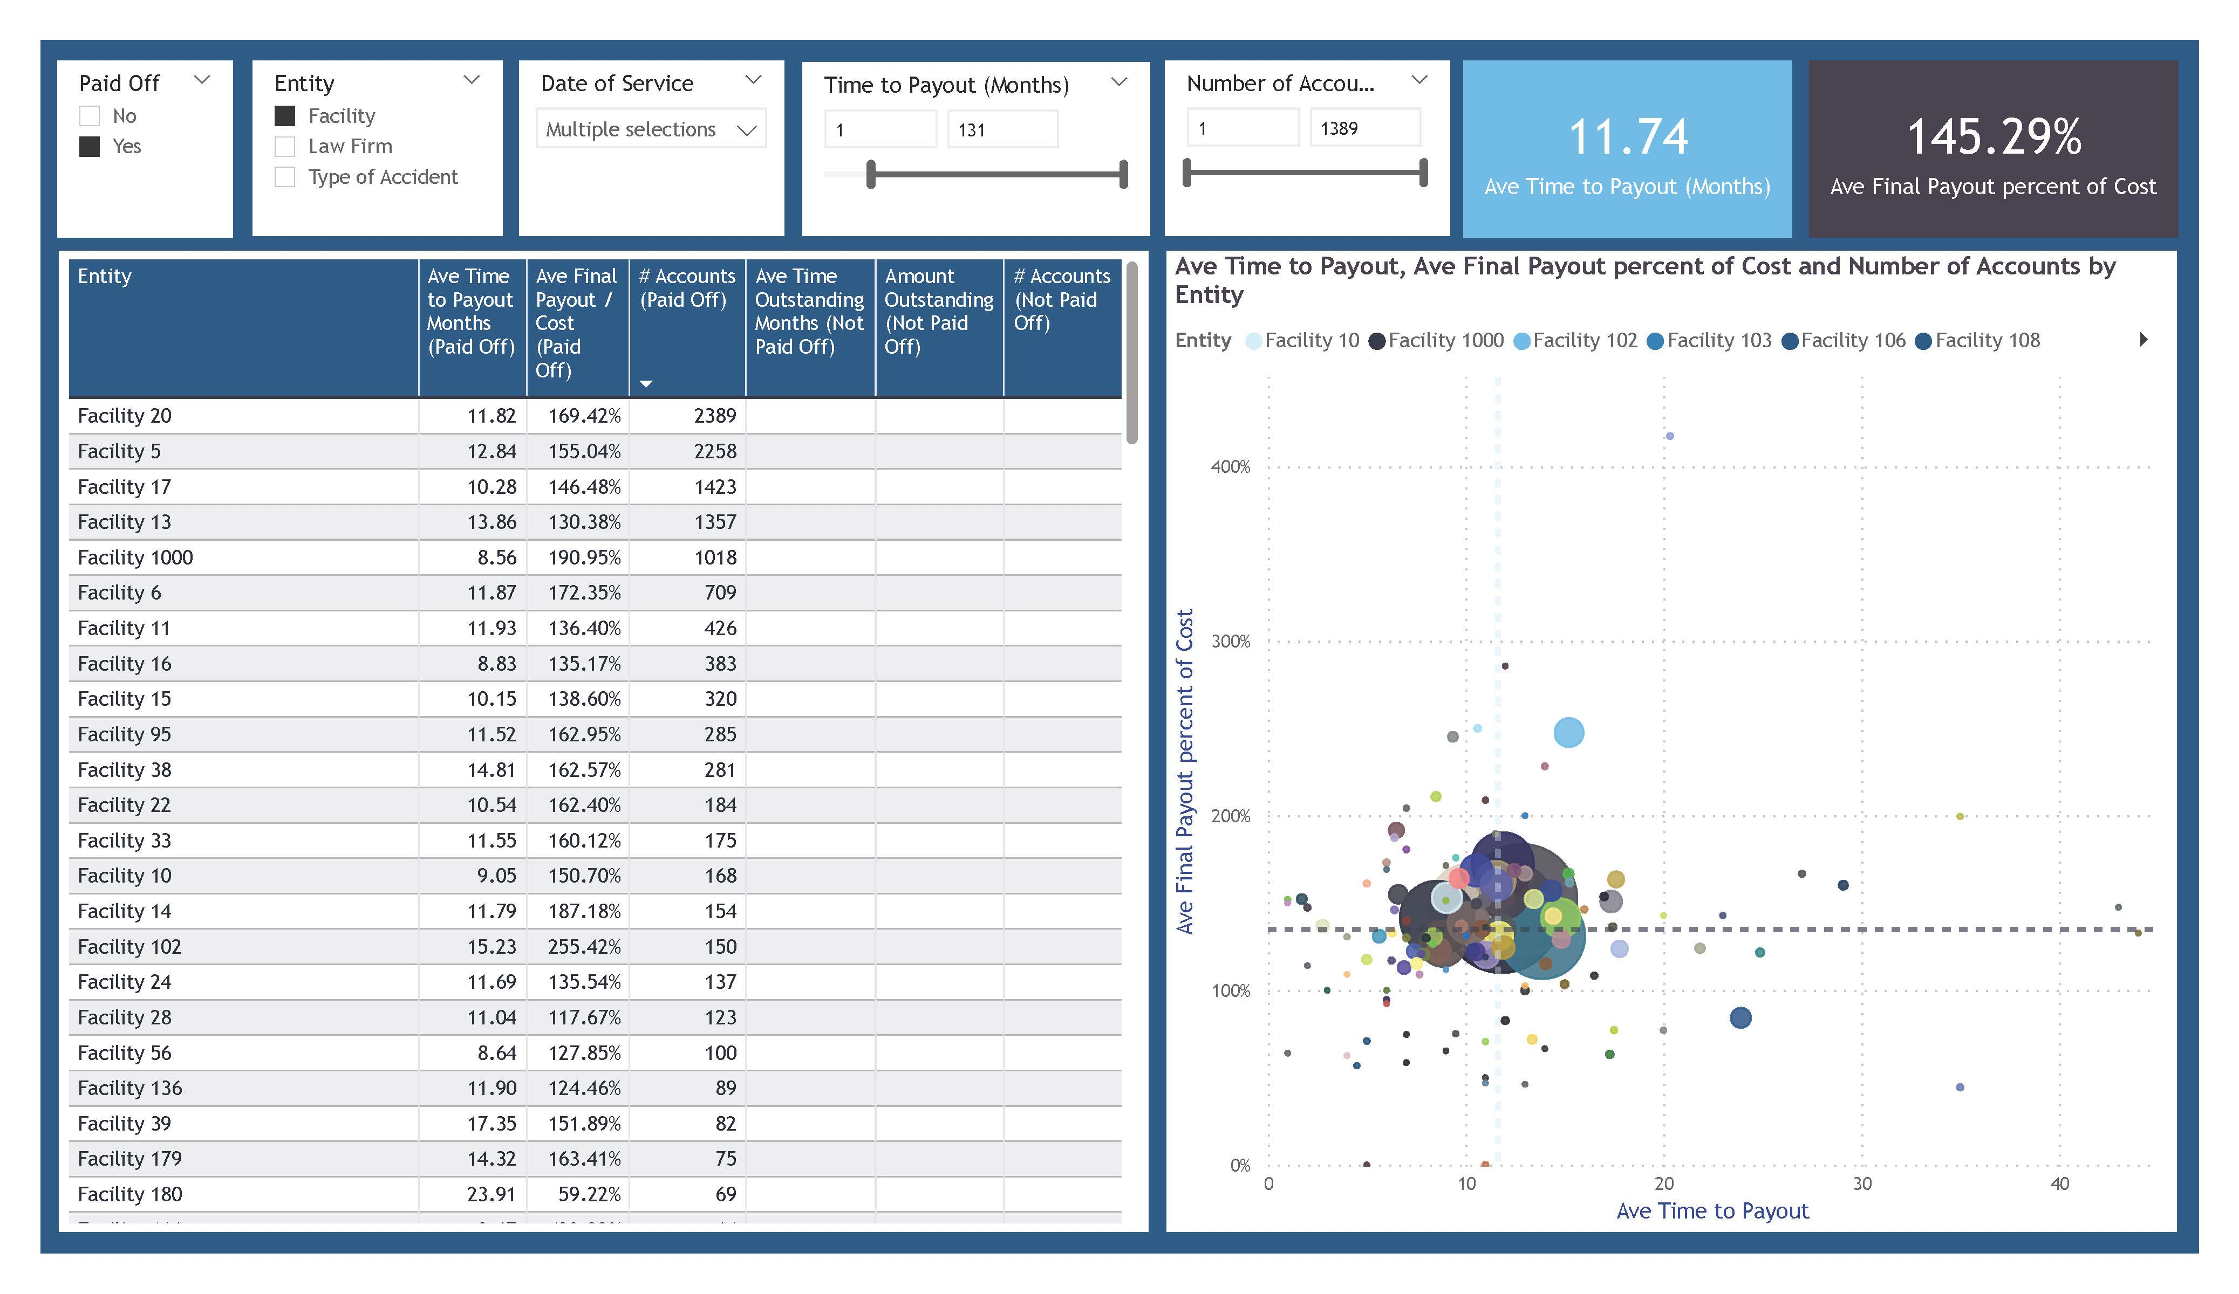
Extract: Excel File in Sharepoint
Load: Power BI
Transform: Power Query
Build Report
Publish App in Power BI Service
Current Client Analytics Demo

Slide 5
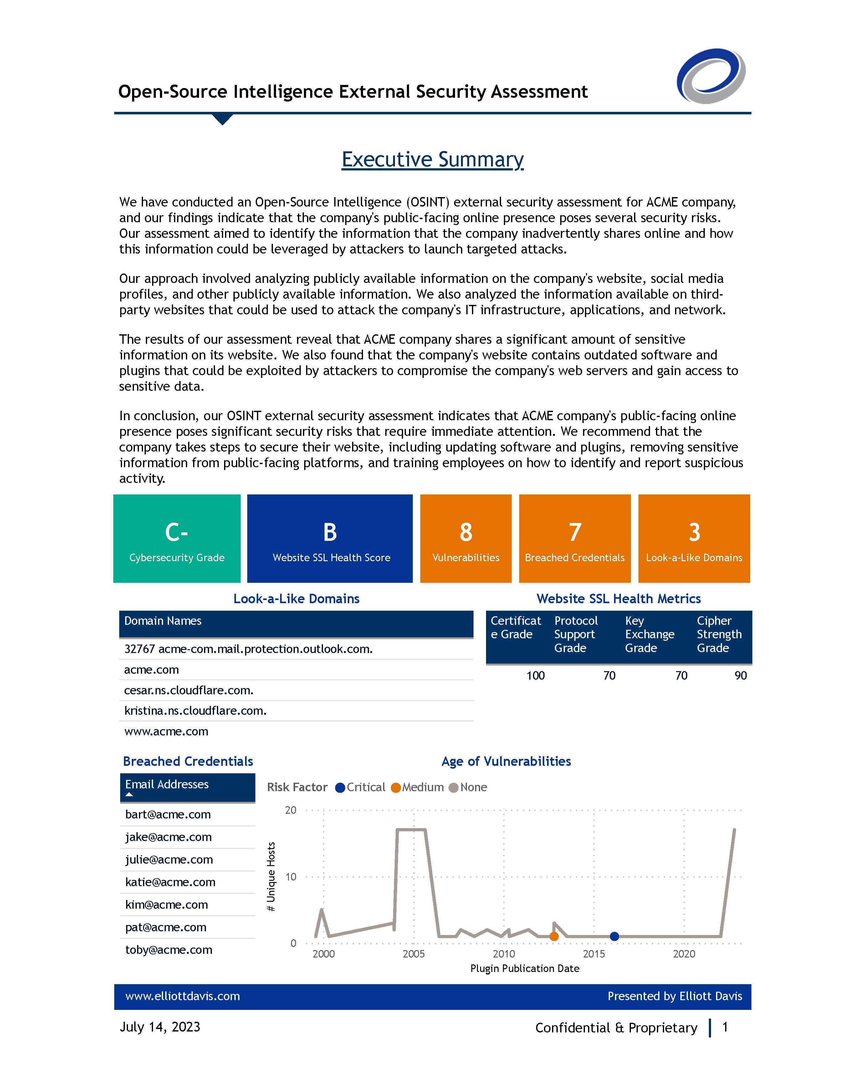
Extract: Excel File in Sharepoint
Load: Power BI
Transform: Power Query
Build Report
Cybersecurity Analytics Report

Slide 6
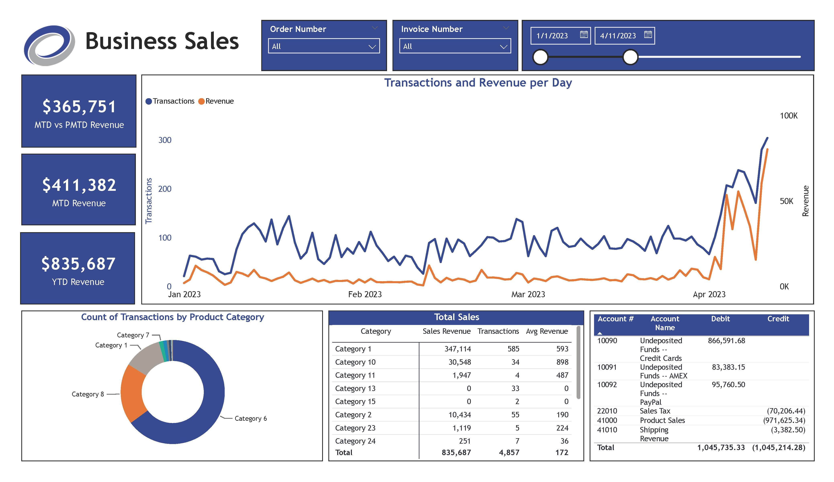

Extract: AWS S3
Load: Power BI
Transform: Power Query
Build Report
Publish App in Power BI Service
External Webinar Dashboards

Slide 7
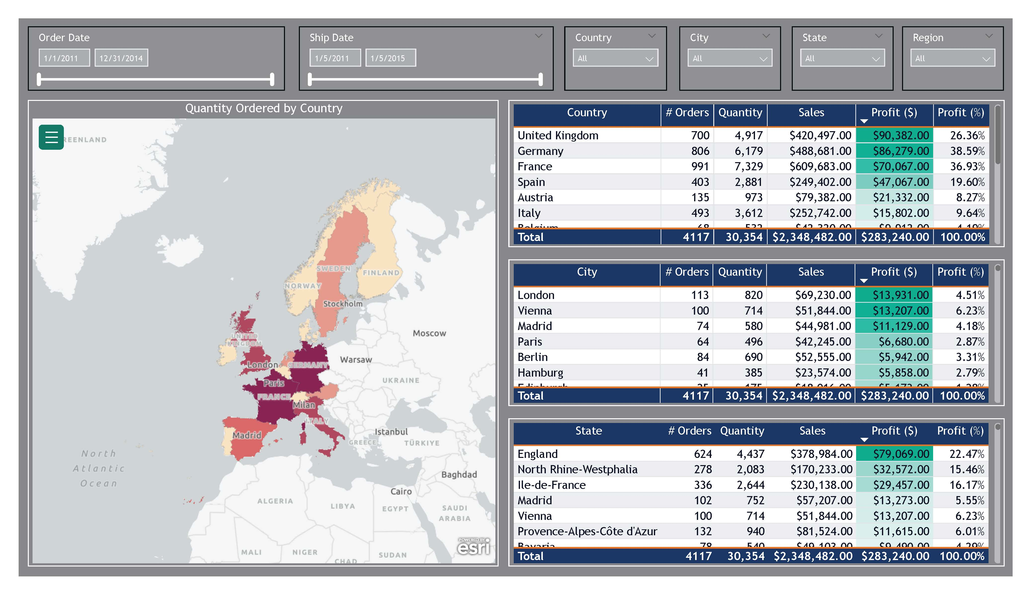
Extract: Excel File in Sharepoint
Load: Power BI
Transform: Power Query
Build Report
Publish App in Power BI Service
Group Case Study Demo

Slide 8
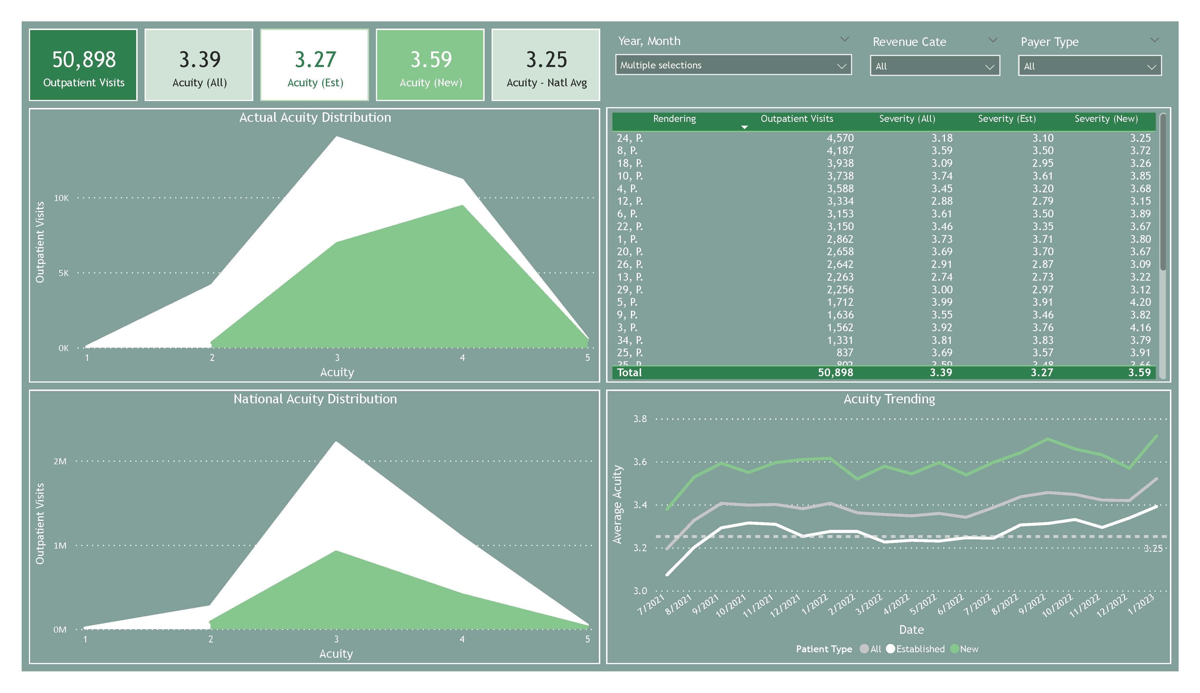
Extract: Excel File in Sharepoint
Load: Power BI
Transform: Power Query
Build Report
Publish App in Power BI Service
Healthcare Ongoing Dashboard

Slide 9
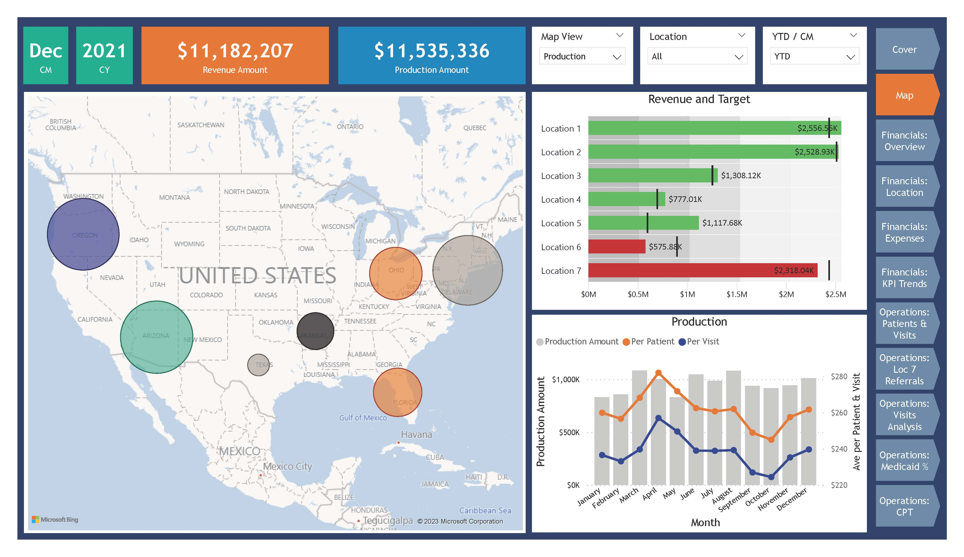
Extract: Excel File in Sharepoint
Load: Power BI
Transform: Power Query
Build Report
Healthcare Private Practice

Slide 10
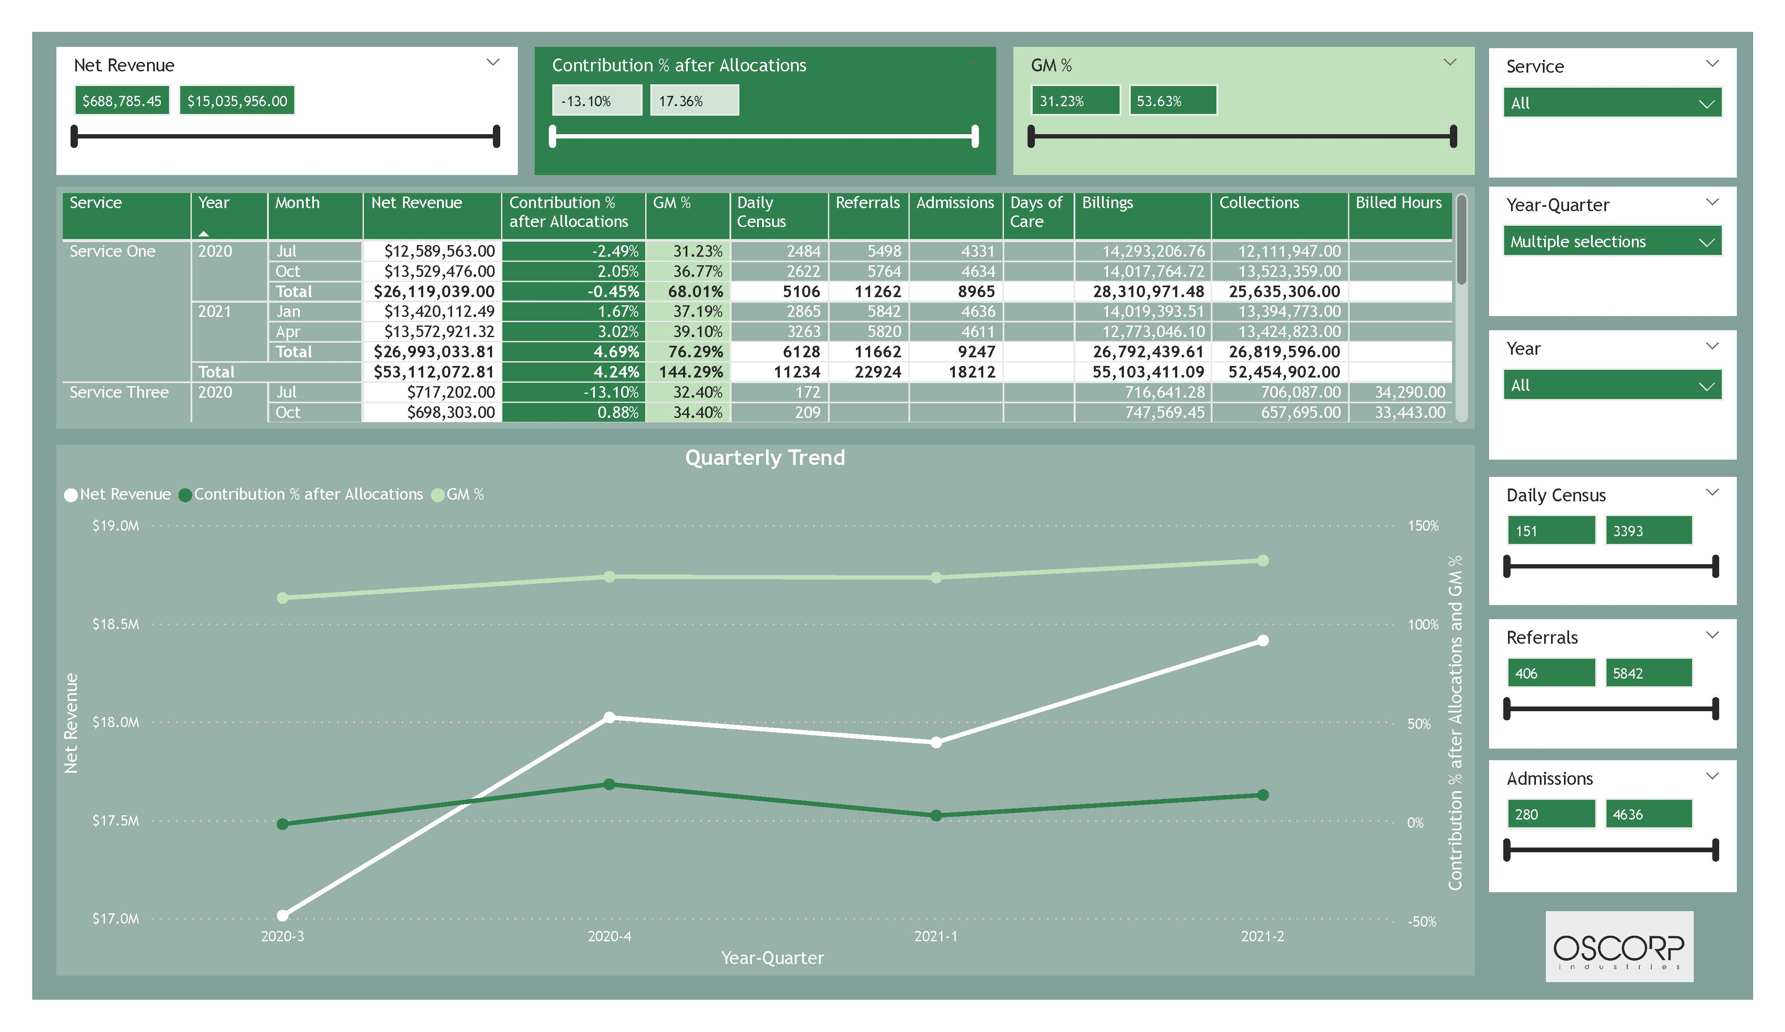
Extract: Excel File in Sharepoint
Load: Power BI
Transform: Power Query
Build Report
Healthcare Proposal Dashboard

Slide 11
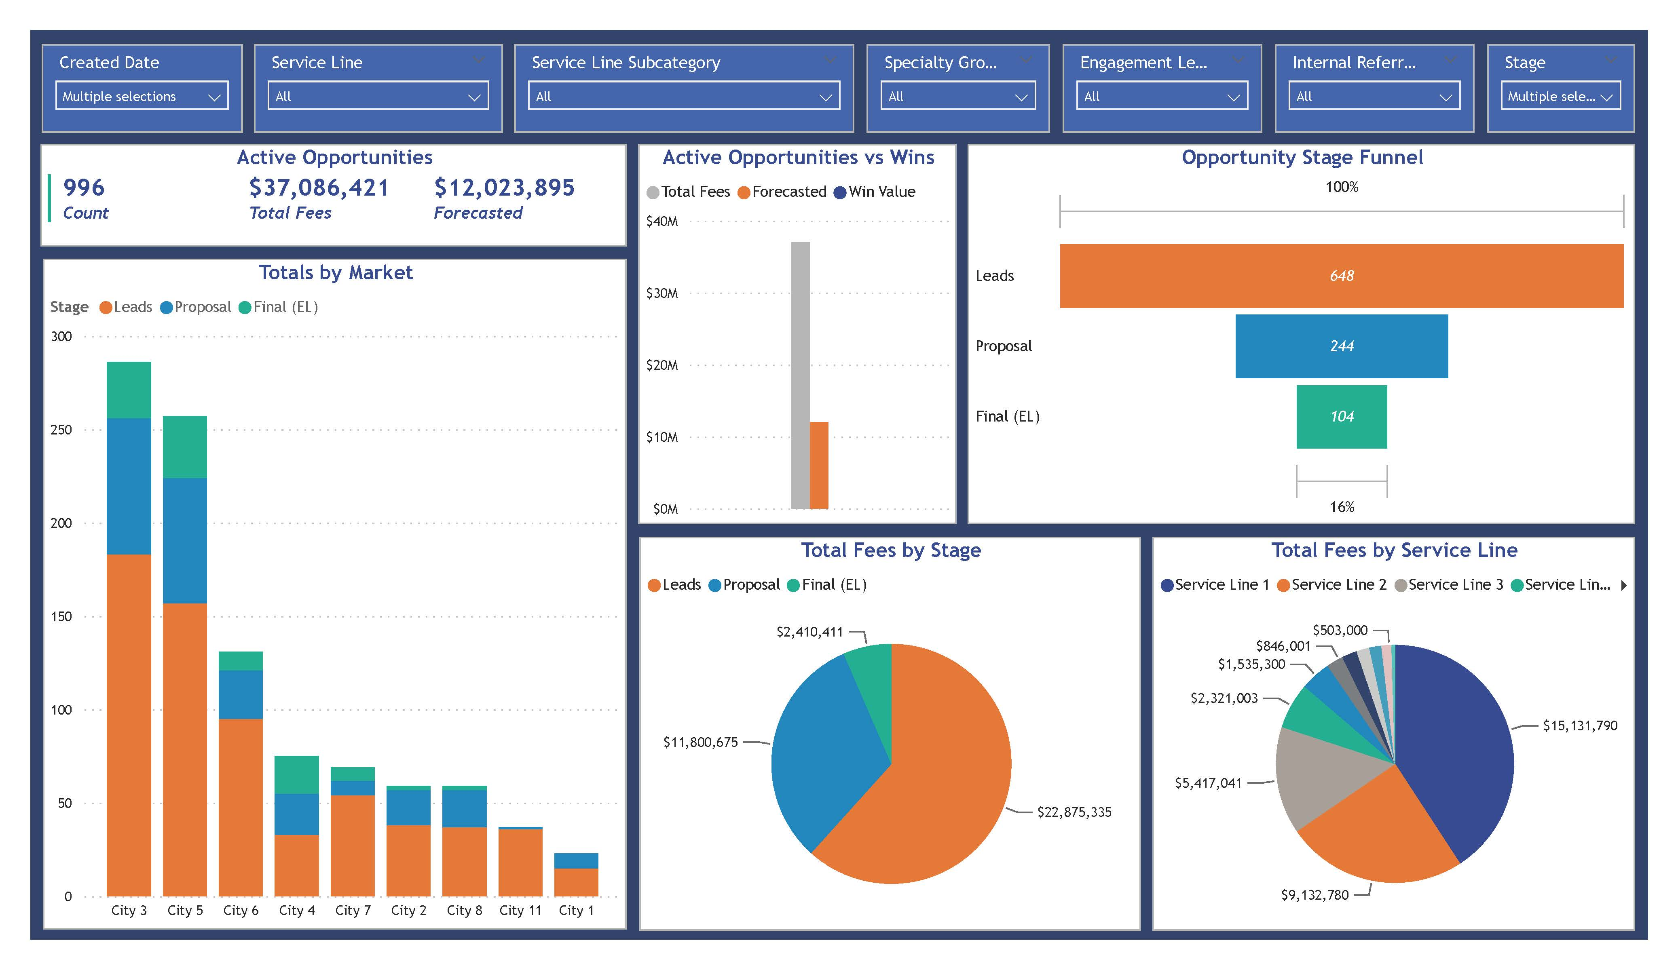

Extract: Smartsheet
Load: Power BI
Transform: Power Query
Build Report
Publish App in Power BI Service
Internal Use Work Tracker

Slide 12
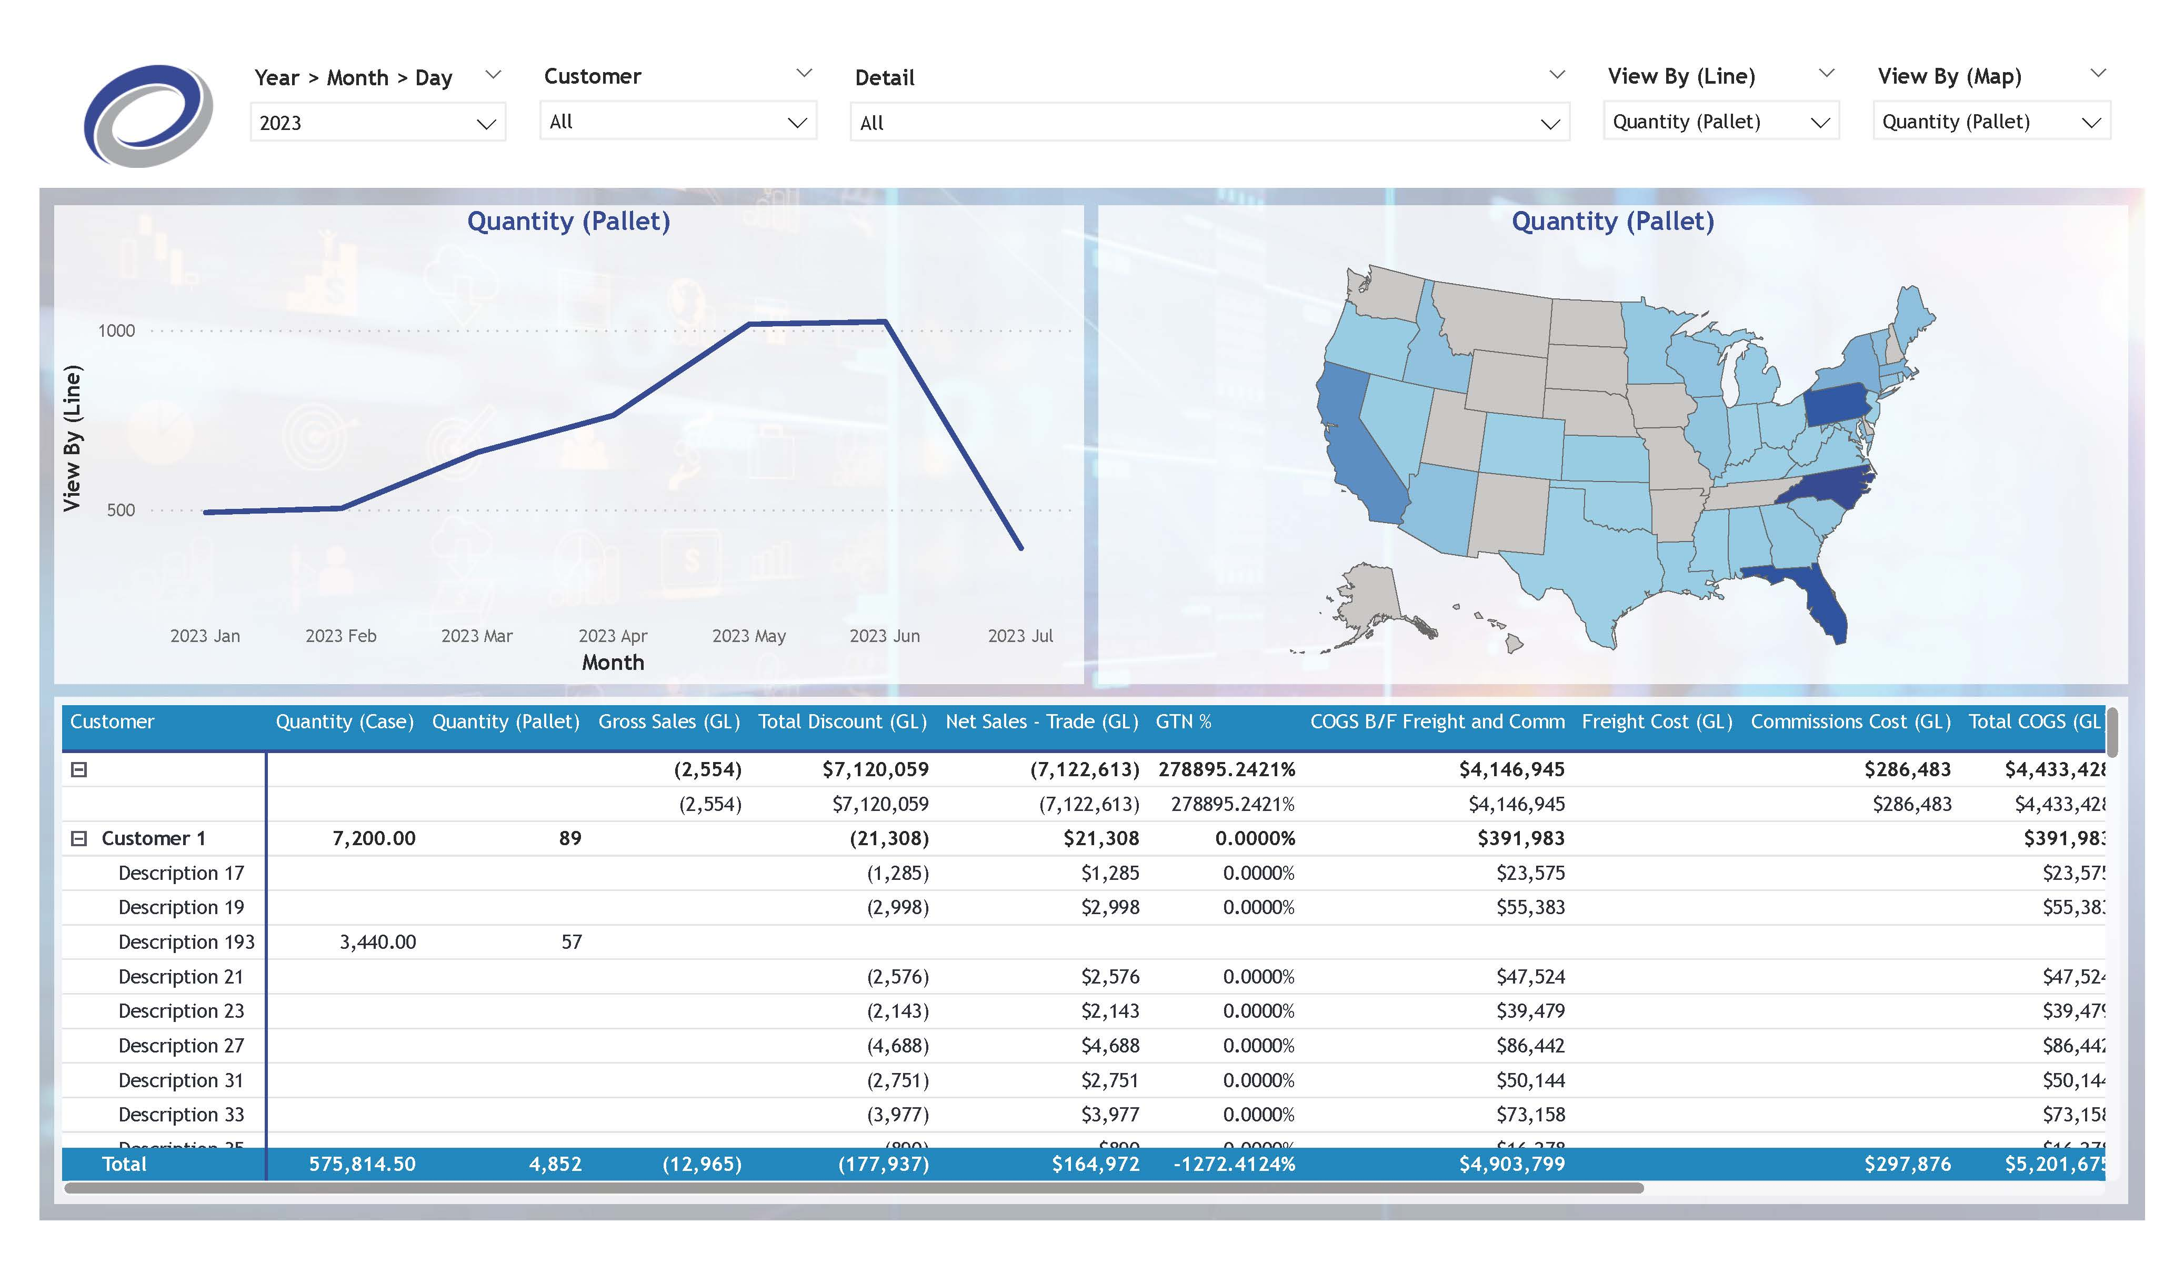

Extract: SQL Database
Load: Power BI
Transform: Power Query
Build Report
Publish App in Power BI Service
Manufacturing Client Demo

Slide 13
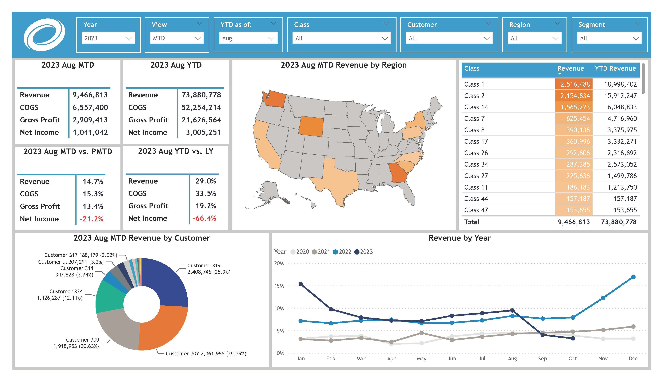

Extract: QuickBooks Online
Load: Power BI
Transform: Power Query
Build Report
Publish App in Power BI Service
Manufacturing QuickBooks Analysis

Slide 14
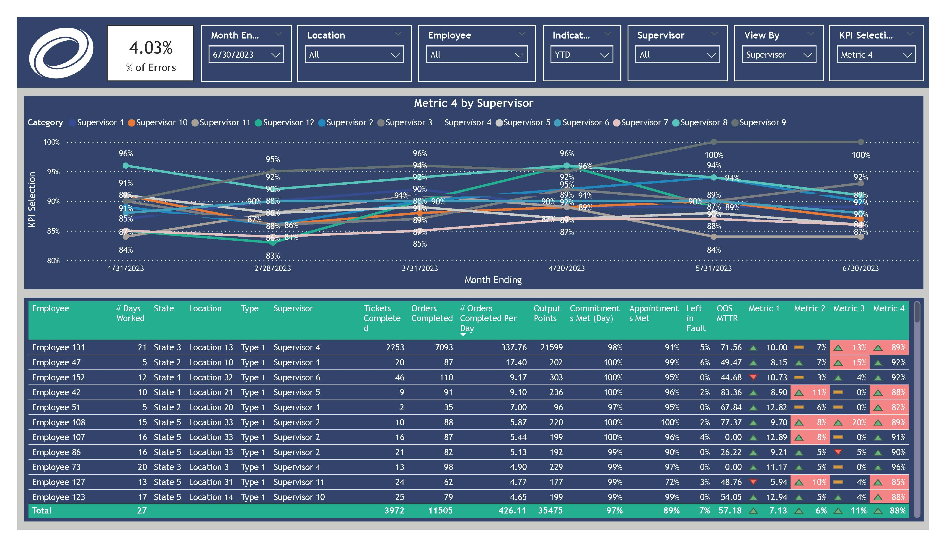
Extract: Excel File in Sharepoint
Load: Power BI
Transform: Power Query
Build Report
Publish App in Power BI Service
Manufacturing Supervisor Dashboards

Slide 15
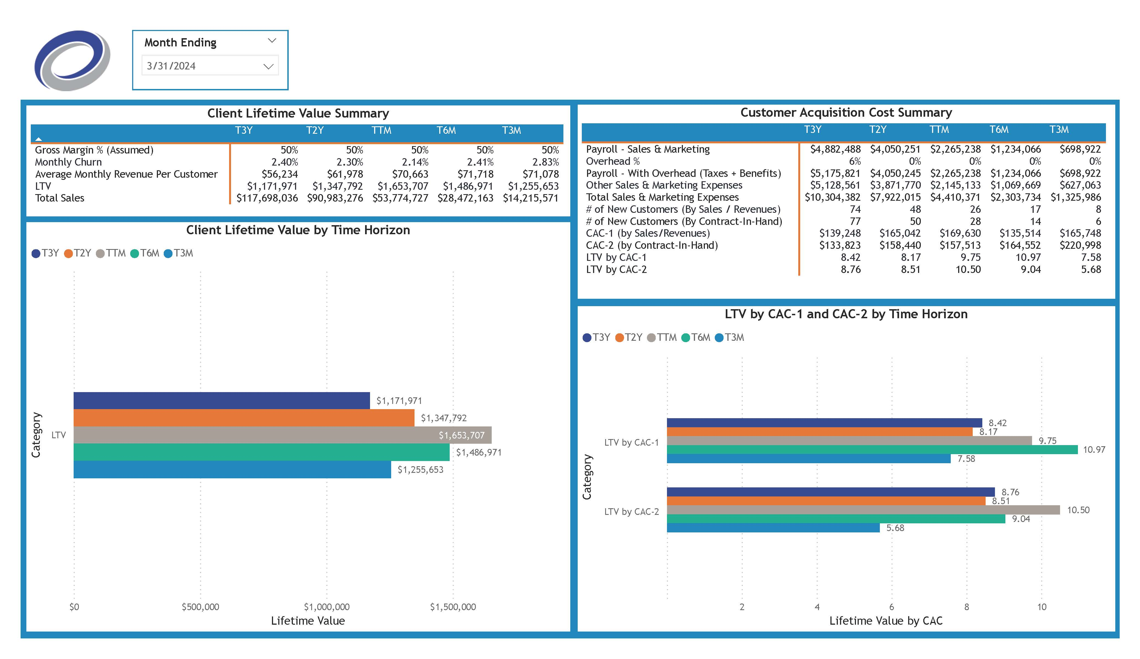

Load: Power BI
Transform: Power Query
Build Report
Publish App in Power BI Service
Extract: QuickBooks Online,
Salesforce,
And an Excel file in Sharepoint
Medical Billing Service Provider Dashboards

Slide 16
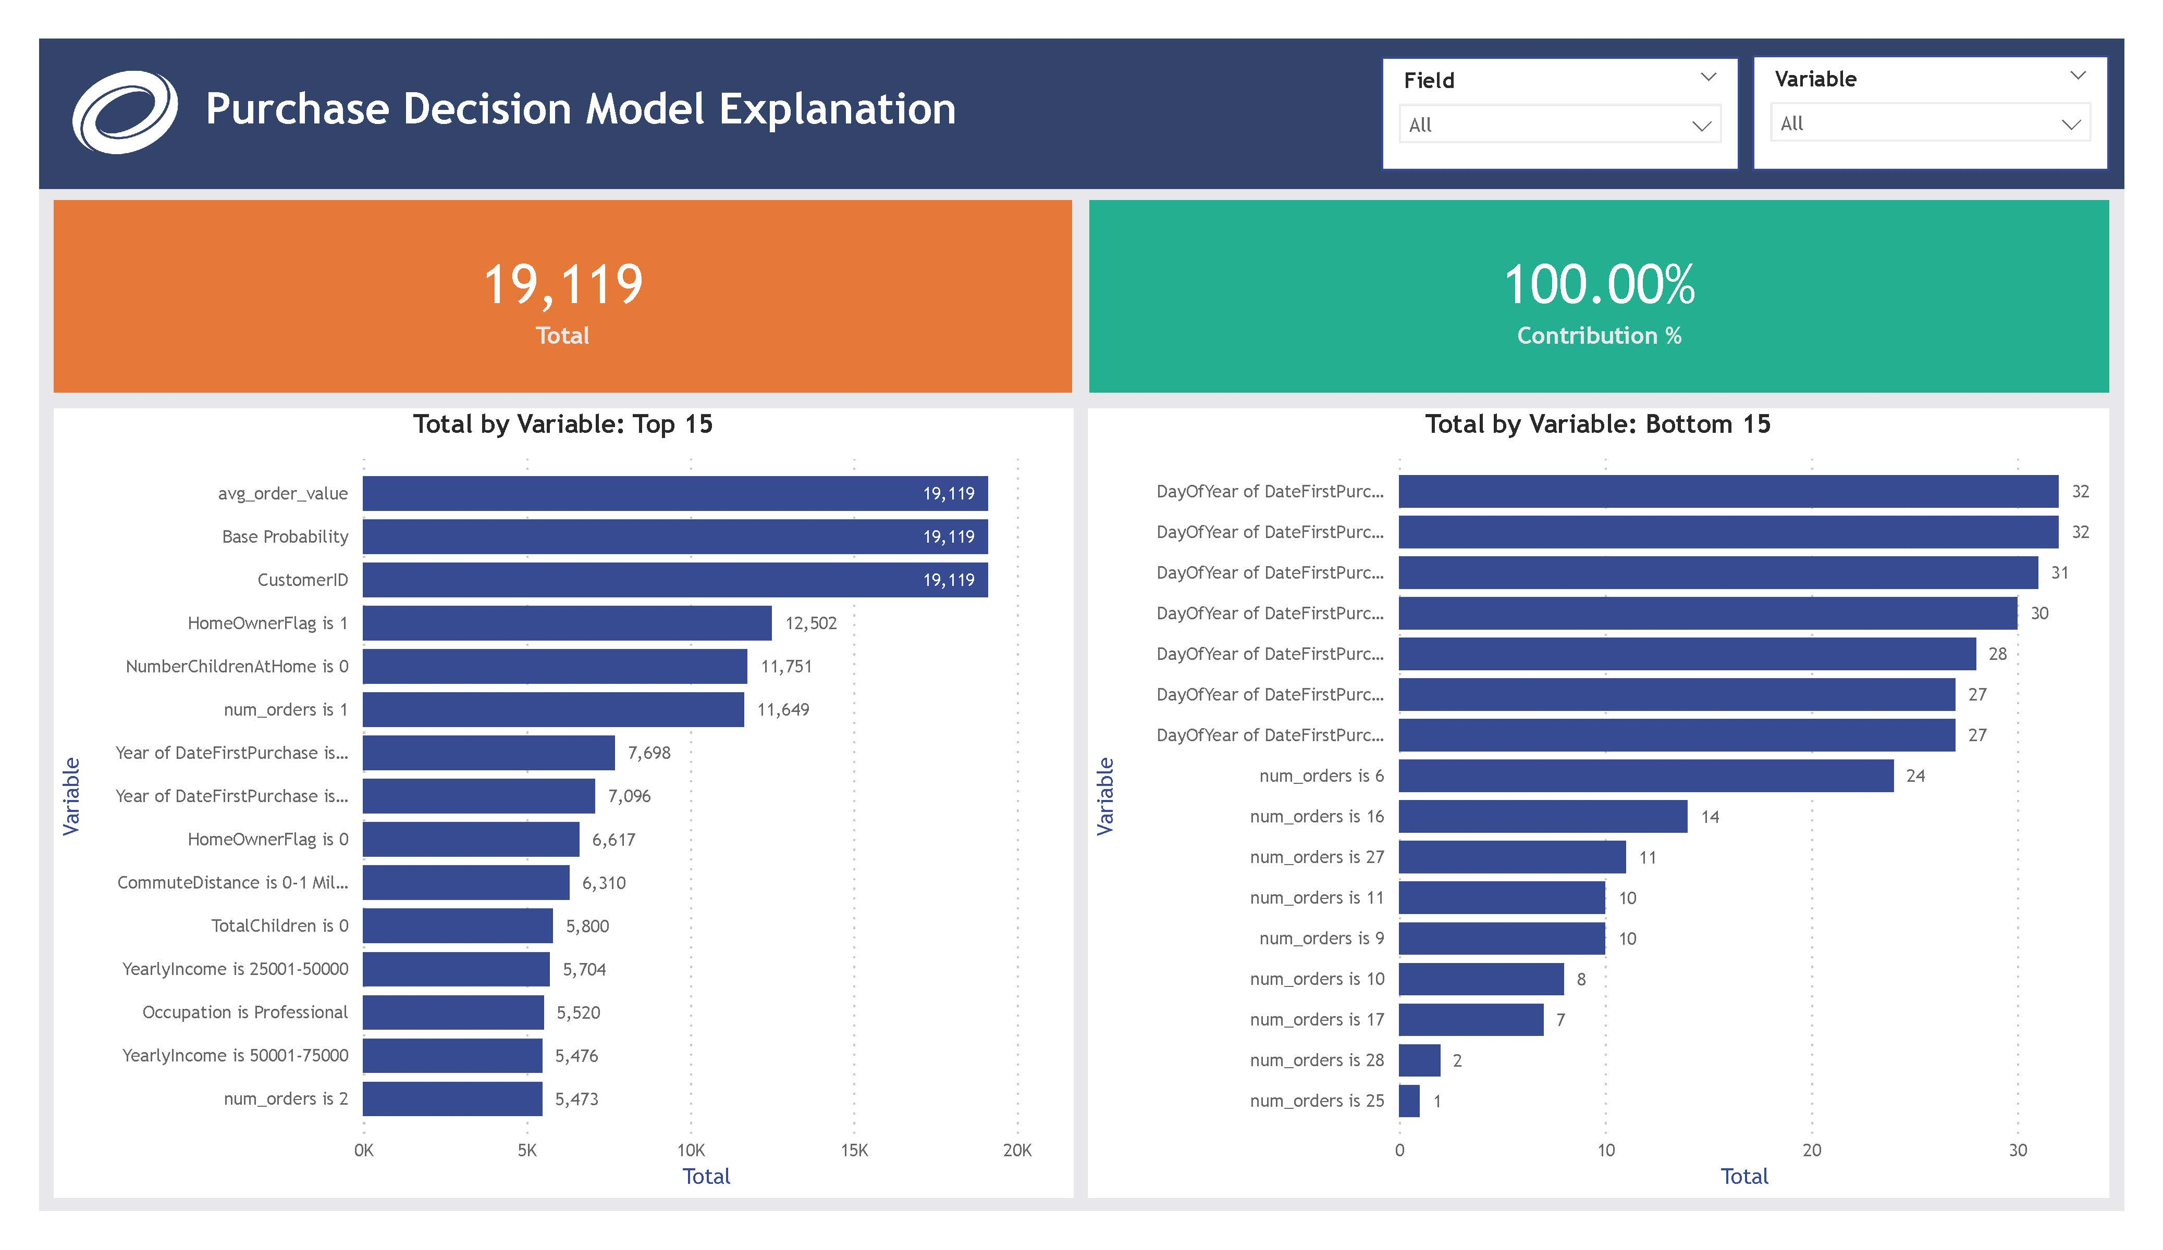
Load: Power BI Service
Transform: Data flows & Power Query
Build ML model
Extract: Excel File in Power BI Service
Build Report in Power BI Desktop
Publish App in Power BI Service
ML Tutorial Project

Slide 17
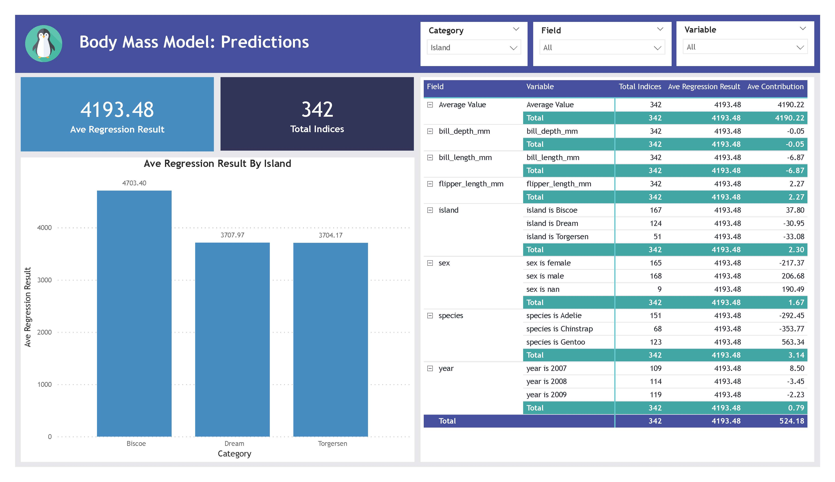
Load: Power BI Service
Transform: Data flows & Power Query
Build ML model
Extract: Excel File in Power BI Service
Build Report in Power BI Desktop
Publish App in Power BI Service
Penguins Power BI ML

Slide 18
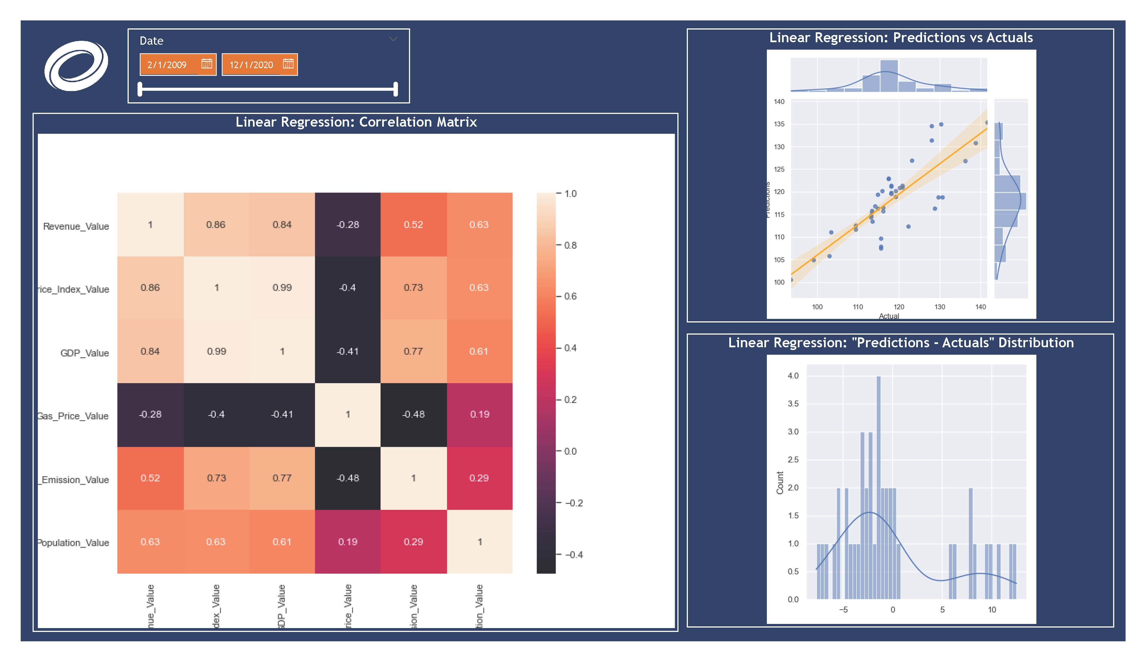

Extract: APIs and Web Scraping with Python
Load: Power BI
Transform: Power Query
Build Report
Extract: Excel File
Power BI + Python + Machine Learning Forecasting

Slide 19
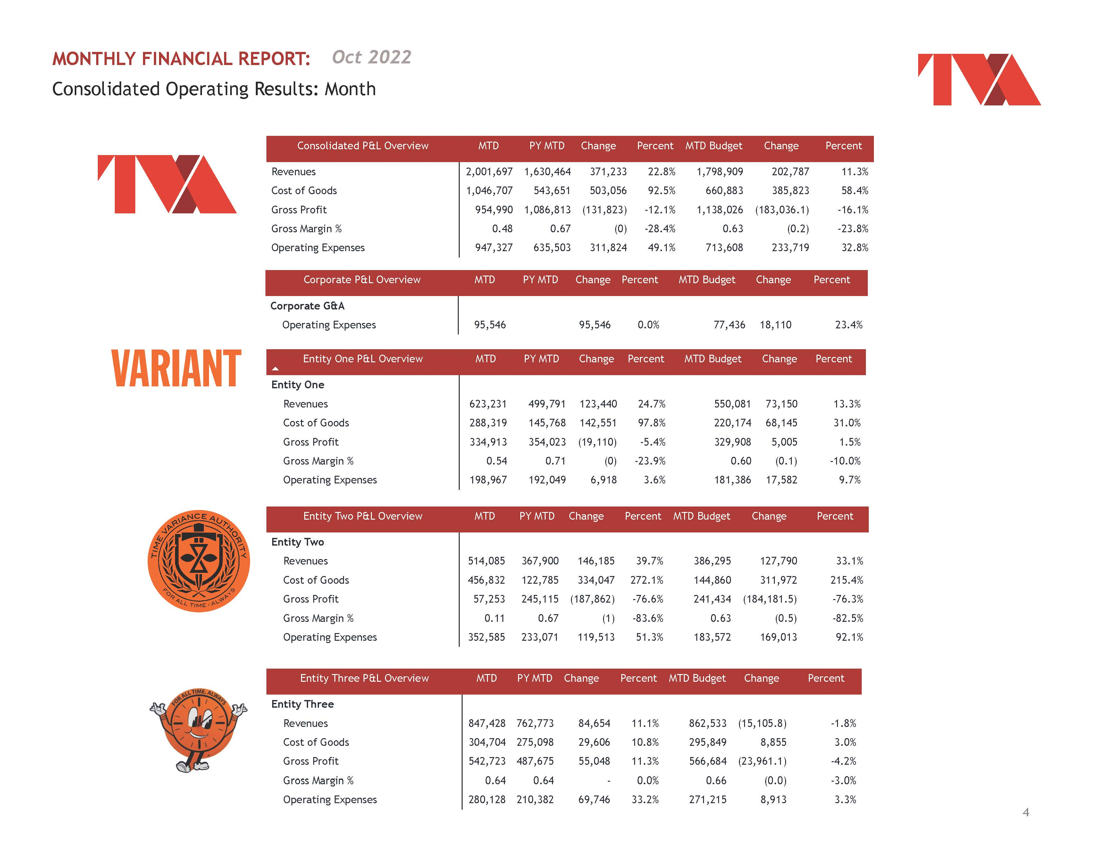
Extract: Excel File in Sharepoint
Load: Power BI
Transform: Power Query
Build Report
Private Equity Financial Reporting Automation

Slide 20
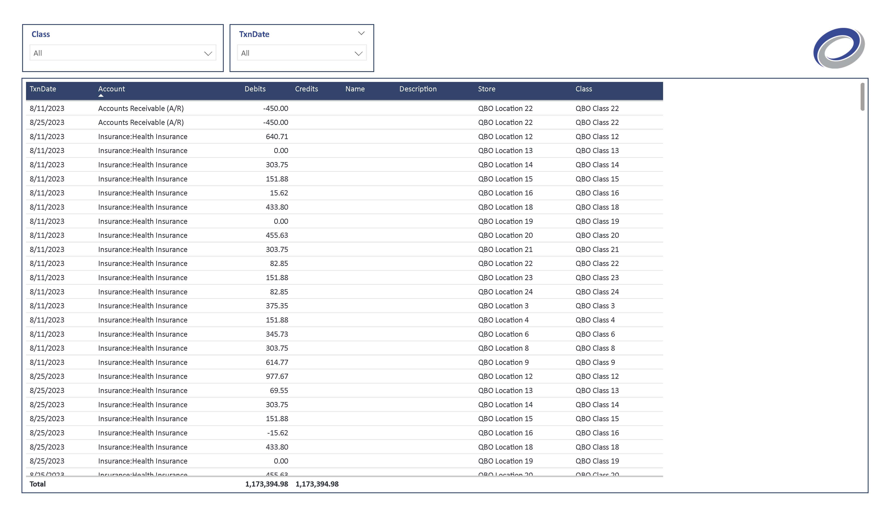
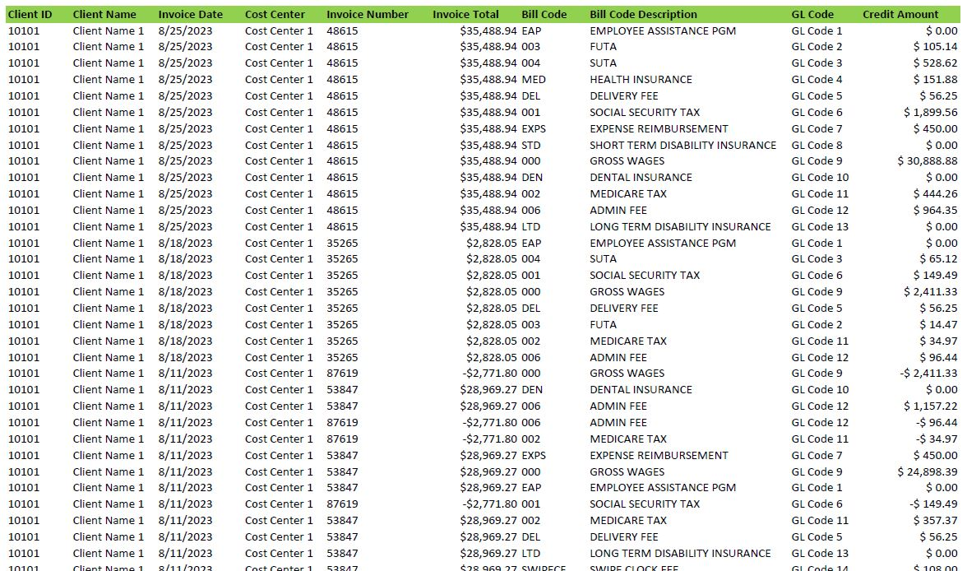
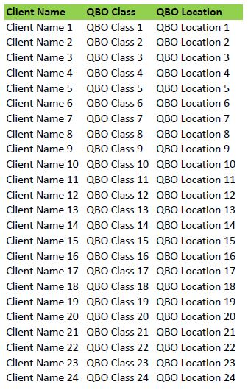
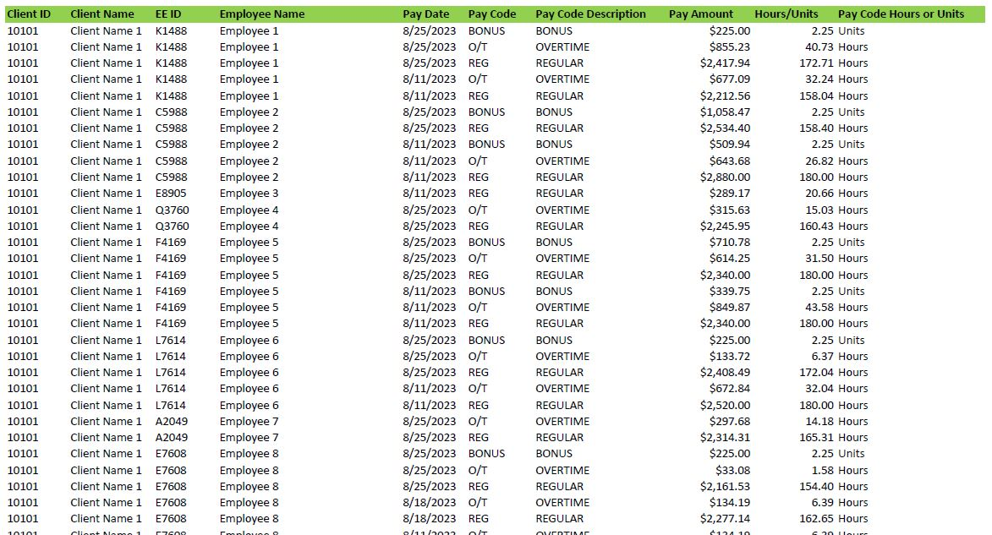
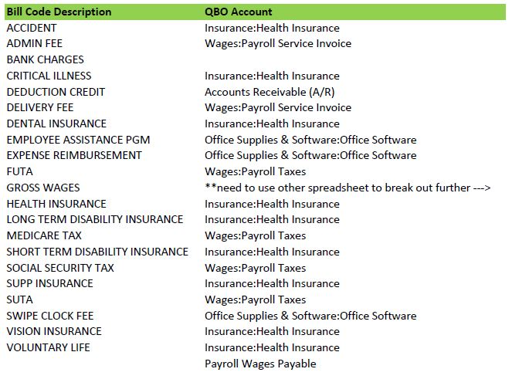
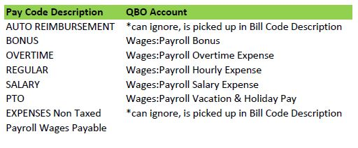
Extract: 2 payroll reports & 3 mapping tables saved in Excel
Load: Power BI
Transform: Power Query
Build final result for import
QBO Payroll Import Automation

Slide 21
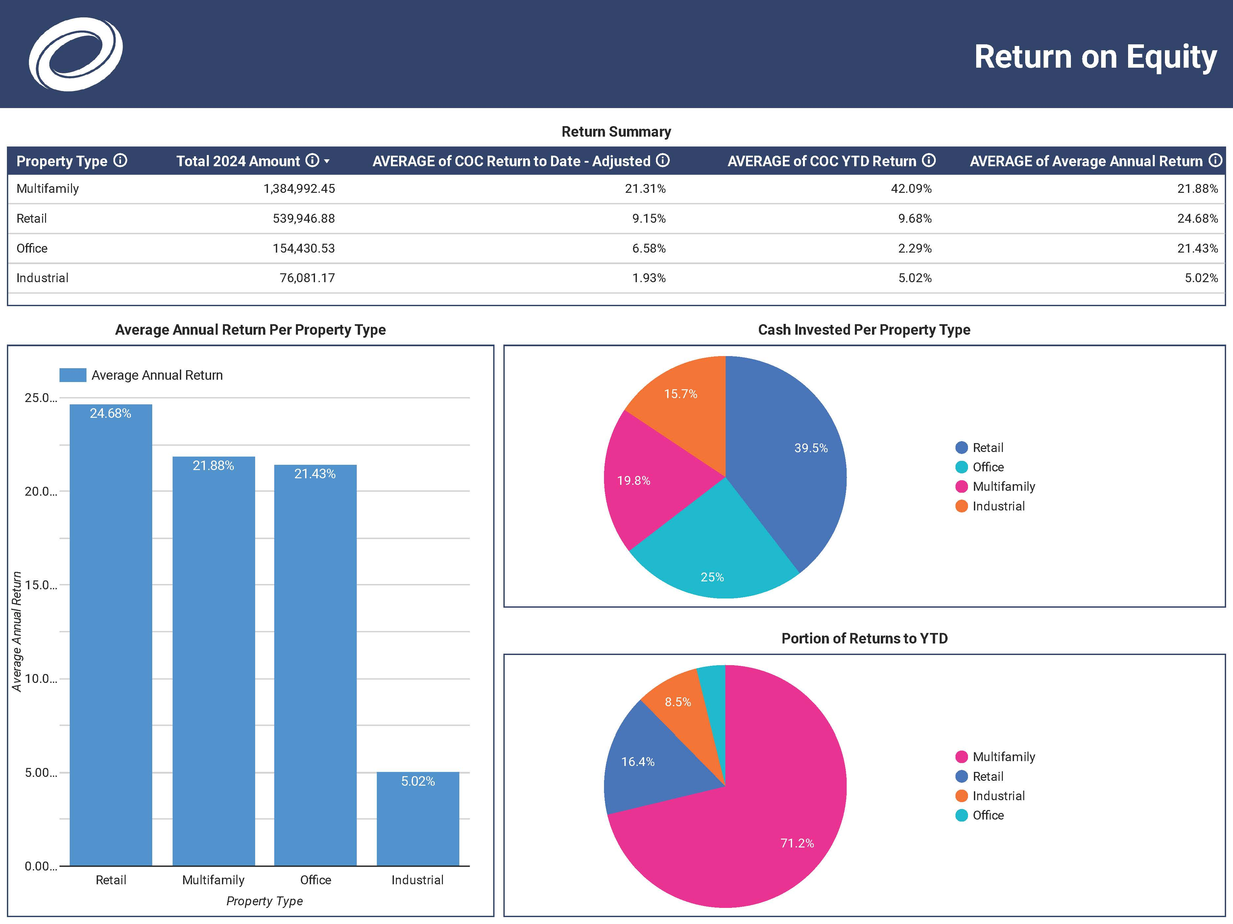



Extract reports from Appfolio property manager into
Google Sheets
Load: Google Looker
Build Report
Real Estate Client Dashboards

Slide 22











Synapse Data Engineering
Synapse Data Science
Data Activator
Teams
API
Data Factory
Power BI
One Lake
Recreation.gov Analytics

